Slide 1
Matrix on the Conversion of Accounts

Slide 2
Matrix on the Conversion of Accounts

Slide 3
Matrix on the Conversion of Accounts

Slide 4
Matrix on the Conversion of Accounts

Slide 5
Matrix on the Conversion of Accounts

Slide 6
Matrix on the Conversion of Accounts

Slide 7
Matrix on the Conversion of Accounts

Slide 8
Matrix on the Conversion of Accounts

Slide 9
Matrix on the Conversion of Accounts

Slide 10
Matrix on the Conversion of Accounts

Slide 11
Matrix on the Conversion of Accounts

Slide 12
Matrix on the Conversion of Accounts

Slide 13
Matrix on the Conversion of Accounts

Slide 14
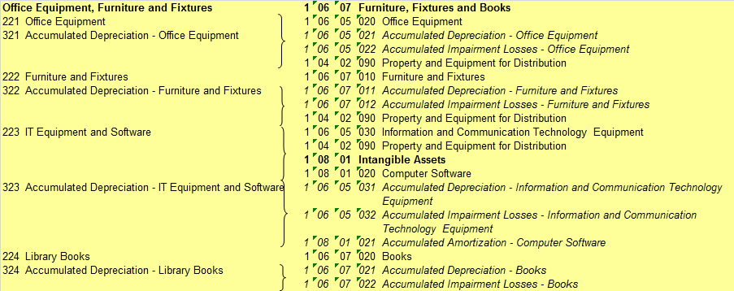
Matrix on the Conversion of Accounts

Slide 15
Matrix on the Conversion of Accounts

Slide 16
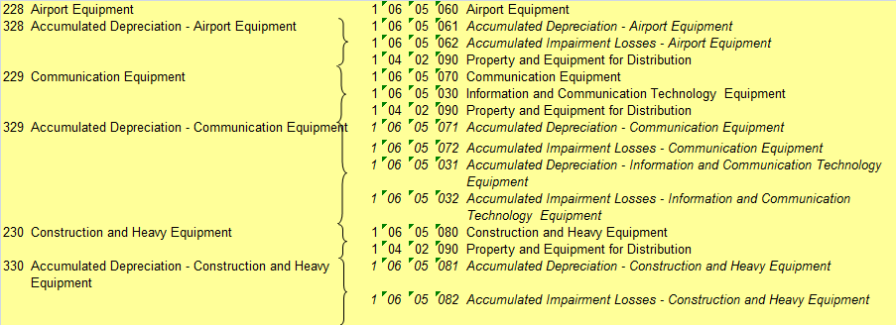
Matrix on the Conversion of Accounts

Slide 17
Matrix on the Conversion of Accounts

Slide 18
Matrix on the Conversion of Accounts

Slide 19
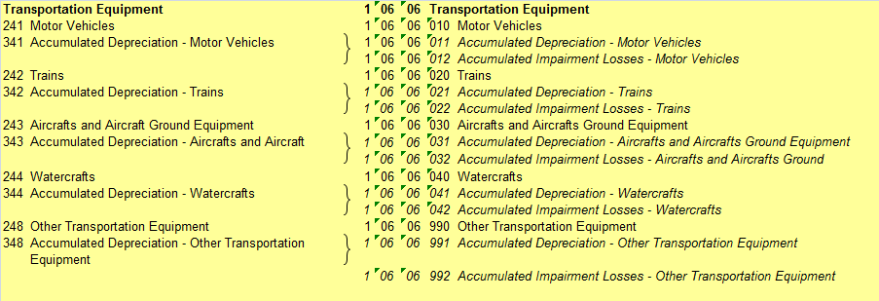
Matrix on the Conversion of Accounts

Slide 20
Matrix on the Conversion of Accounts

Slide 21
Matrix on the Conversion of Accounts

Slide 22
Matrix on the Conversion of Accounts

Slide 23
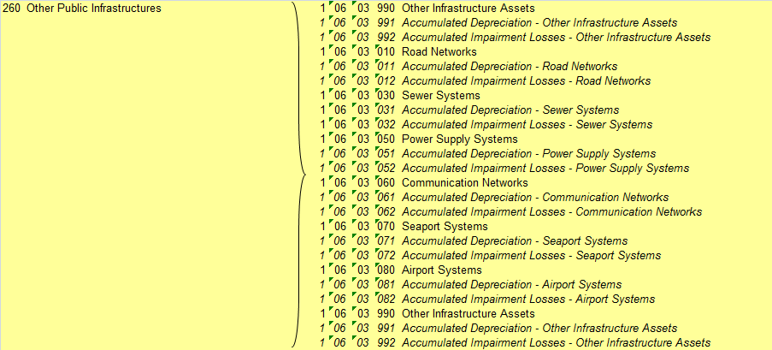
Matrix on the Conversion of Accounts

Slide 24
Matrix on the Conversion of Accounts

Slide 25
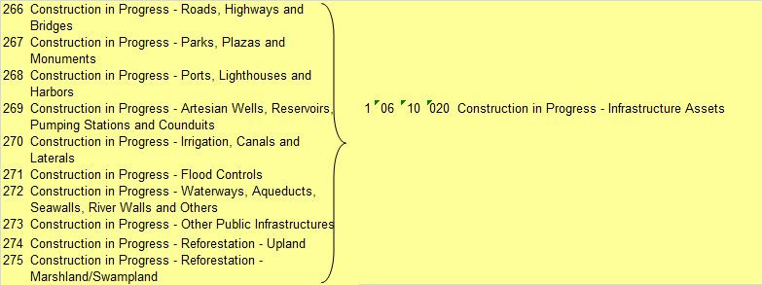
Matrix on the Conversion of Accounts

Slide 26
Matrix on the Conversion of Accounts

Slide 27
THANK YOU!

