Slide 1
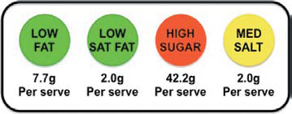
Figure Sample Front-of-Package Label from the
Traffic-Light System Used in Britain.

Slide 2
FDA UPDATES
on Front of Pack (FOP) & Food Labeling
1. Voluntary declaration – Issued last Dec. 13, 2012 FDA Circular on FOP on Energy/Calorie (FDA Circular No. 2012-015)
2. Mandatory declaration – On going review/revision on amendment of Administrative Order (AO) on Food Labeling (AO 88-B. s. 1984)
Notes:
2

Slide 3
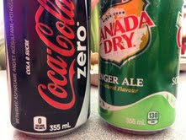
FOP on energy/calorie shall be based on the following :
Each ___ g serving contains
illustration /sample
Format of Energy declaration on FOP on principal display panel in cylindrical shape (color: white background; print lines: in good contrast with the background)
Information on cylindrical shape: 1) Amount of energy/calories per serving of food; 2) Energy or Calories; 3) Percentage of calorie value based on RENI for energy
Calories:
40
10% RENI
Notes:
3

Slide 4
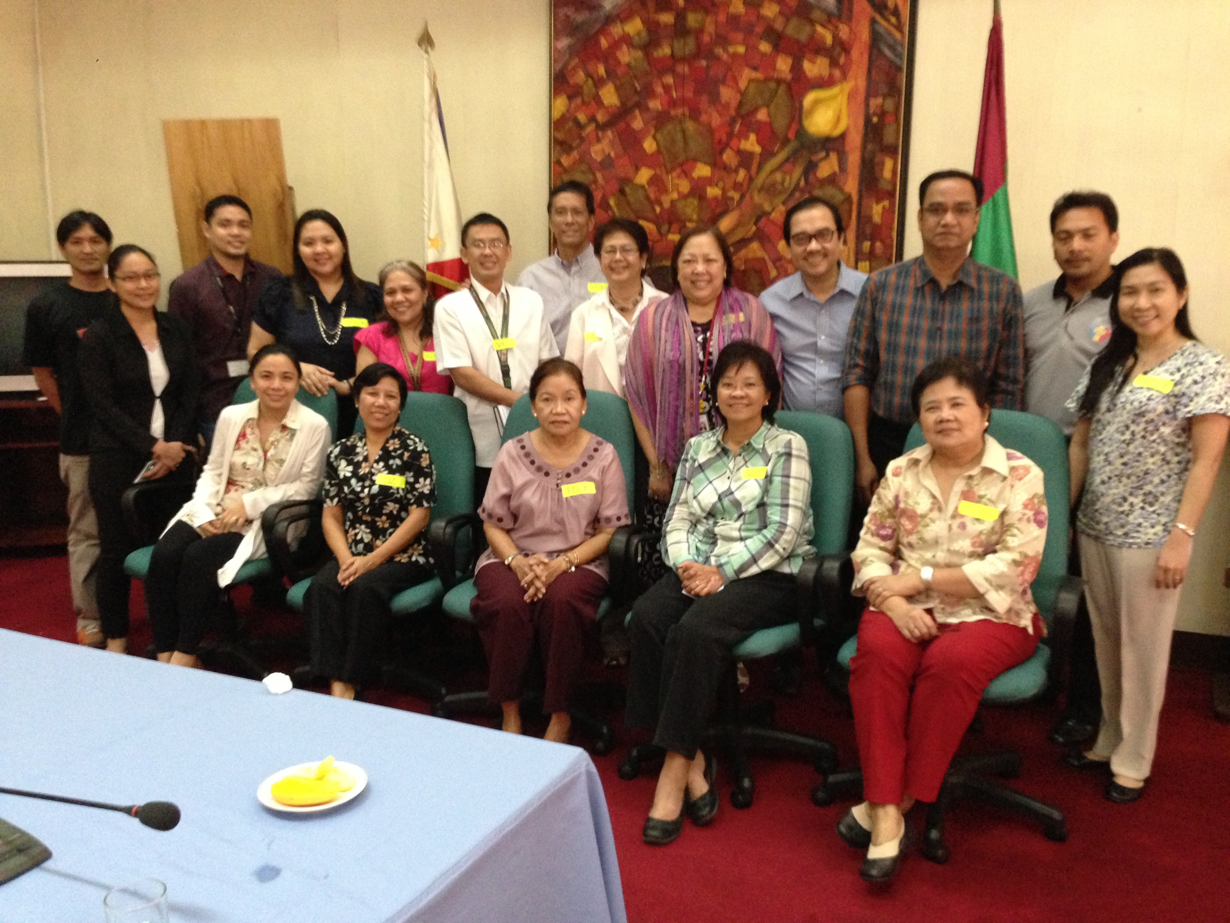
FOP RCT Taskforce
Feb 28,2013
UP Manila

Slide 5
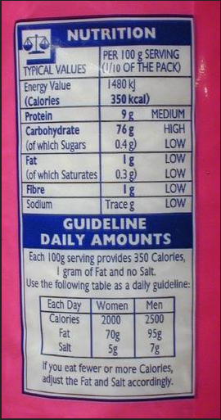
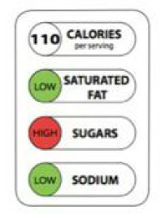
Real Life
Laboratory
POPULATION
Individuals
Clusters
Urban
Rural
EXPOSURES
Mandatory
Voluntary
OUTCOMES
Self-Reported Consumption
Observed Consumptionor Sales
Reformulation
Health

Slide 6
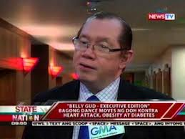
Belly Gud for Health 2013
The DOH Executive Edition

Slide 7
January -July 2013
In the Department of Health Central Office, from a total of 779 personnel taken waist circumference in 2012 prior to the conduct of Belly Gud for Health, 362 or 46.5% have waist circumference above desirable levels. ☺

Slide 8
Food Plate replaces Pyramid
Food Pyramid (1992)
Food Plate (2011)

Slide 10
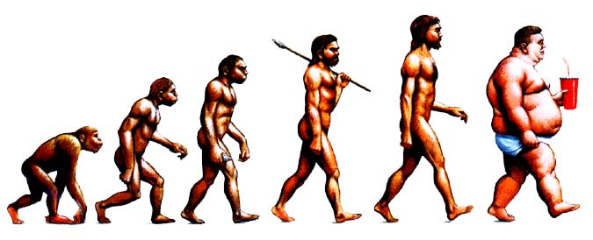
“It is not the strongest of the species that survives, nor the most intelligent that survives. It is the one that is the most adaptable to change.”
Charles Darwin, The Origin of Species
Shape the Environment

Slide 11
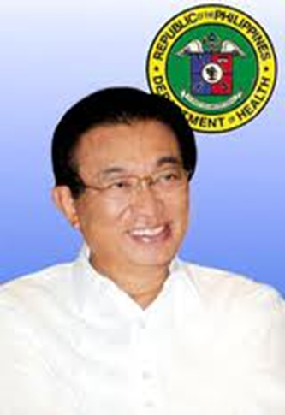
Multi Sectoral Approach
Department of Health
Sin tax on tobacco and alcohol approved ( with DOF)
Mandatory Food Labeling
No smoking in public places (MMDA)
No smoking , no sodas and junk foods, exercise 30 mins 3x a week – schools, workplaces, LGUs
Implementation of Framework Convention on Tobacco Control, restriction on trans fats, provision of pedestrian pathways or bike paths, food labeling, and salt restriction

Slide 12
Multi Sectoral Approach
DepEd /CHED
)
No smoking in schools, no sodas and junk foods, exercise 30 mins 3x a week
Implementation of Framework Convention on Tobacco Control,
restriction on trans fats,
provision of pedestrian pathways or bike paths,
food labelling, and salt restriction

Slide 13
Multi Sectoral Approach
DOLE (Workplace)
Healthy workplaces with smoke free policies, healthy diet options, facilities for physical activity
supported by management to shape behavior and health outcomes of employees
Help of prevention of NCDs in the workforce, eventually leading to reduction in sickness, absenteeism, medical expenses, increase in employee productivity

Slide 14
Multi Sectoral Approach
DILG (LGUs)
No smoking in schools, no sodas and junk foods, exercise 30 mins 3x a week
Implementation of Framework Convention on Tobacco Control, restriction on trans fats, provision of pedestrian pathways or bike paths, food labelling, and salt restriction
Urban planning and Active Transport Model

Slide 15
SCHOOL
WORKPLACE
COMMUNITY
TOBACCO CONTROL
Education
Education
Education
Tobacco ban
Tobacco ban
Tobacco ban
Ad bans
Ad bans
Ad bans
Pic warnings
Pic warnings
Pic warnings
Sin Tax
HEALTHY DIET
Education
Education
Education
Health Food?
Health Food
Labelling
Food Bans ☺
Food Bans?
Price reduction
Sin Tax
REGULAR
EXERCISE
Education
Education
Education
More P.E.
Gym Facilities
Fun Run
Stand Desks
Parks
Daily Exercise
Sidewalks
Competitions
Bike Lanes

Slide 16
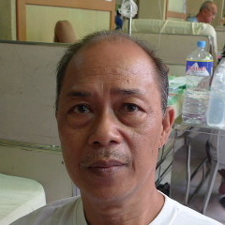
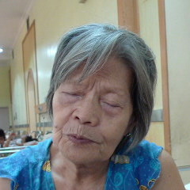
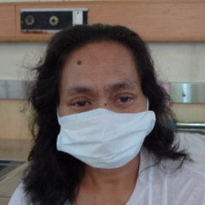
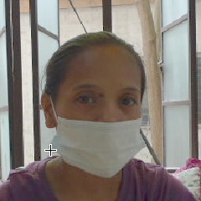
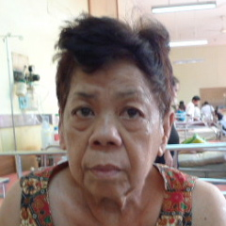
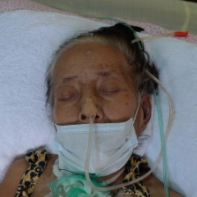
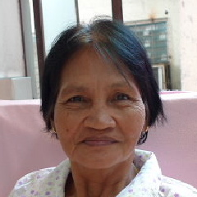
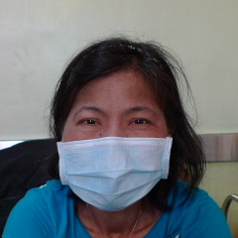
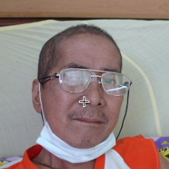
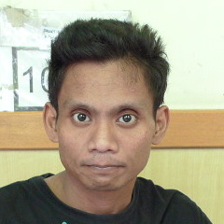
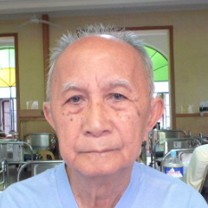
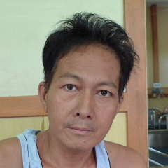
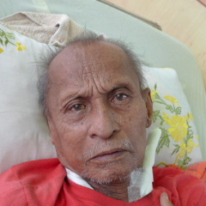
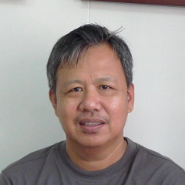
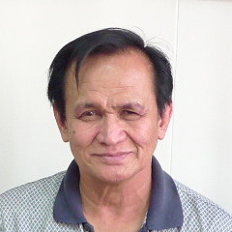
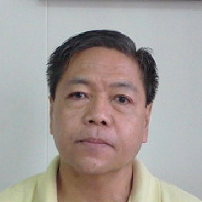
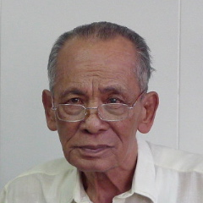
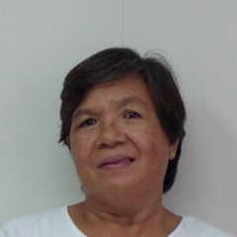
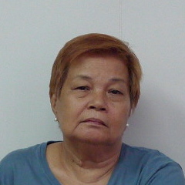
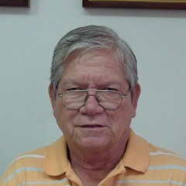
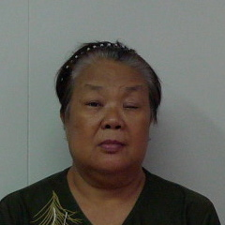
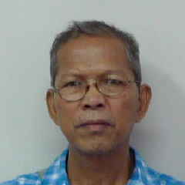
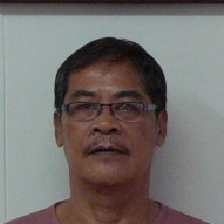
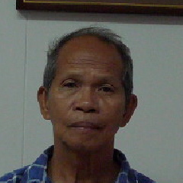
NCD victims: the patients are dying silently …simply because they don’t have power and voice
Notes:
There is no explosion, howling winds, and the earth does not shake
there are no screams for help
The victims suffer quietly
And news crews cannot rush to the scene of the NCD disaster – because it’s happening everywhere, and every minute
I walked around PGH yesterday to try and capture the news, so to speak
I interviewed the patients, and took pictures, which they have kindly allowed me to share
More than half of the people I met suffered NCD,
The youngest was a 28 year old female
And the oldest was an 84 year old male
All were poor and financially strapped
And believe me, the only thing worse than being sick, is being sick and having no money
One story I’ve been allowed to share is that of a 54 year old male from cavite, who was diagnosed to have coronary disease
He has 3 kids and a wife that depend on him. He works as a family driver, but because of his illness, he had to resign from his job months ago
His angiogram last Tuesday showed 3-vessel disease and he doesn’t know where to get the 200k he needs for a charity bypass
He went home today, and has been asked to come back when he’s ready
We see many patients like Mr. Sta. Maria. Most of them, we never see again after being sent home to search for cash.
We need to replace the sterotypical 80M admitted to a plush Manila hospital and is saved by the latest and most expensive technology.
The stereotype is MR. Sta Maria, a middle aged, honest, productive blue collar worker, who cannot pay huge sums to save his family
Mr. Sta Marta blames himself, his smoking and lack of exercise and unhealthy diet
But forces beyond him have forced him down this way
We need to do something upstream – not as doctors or the DOH, but as members of a society that have caused this epidemic
Unless we start doing something NOW, then we will continue to lose life after life after life
In this silent disaster.

Slide 17
Real Change Hurts ( Thumbs down sign at Sen Recto’s Office)

Slide 18
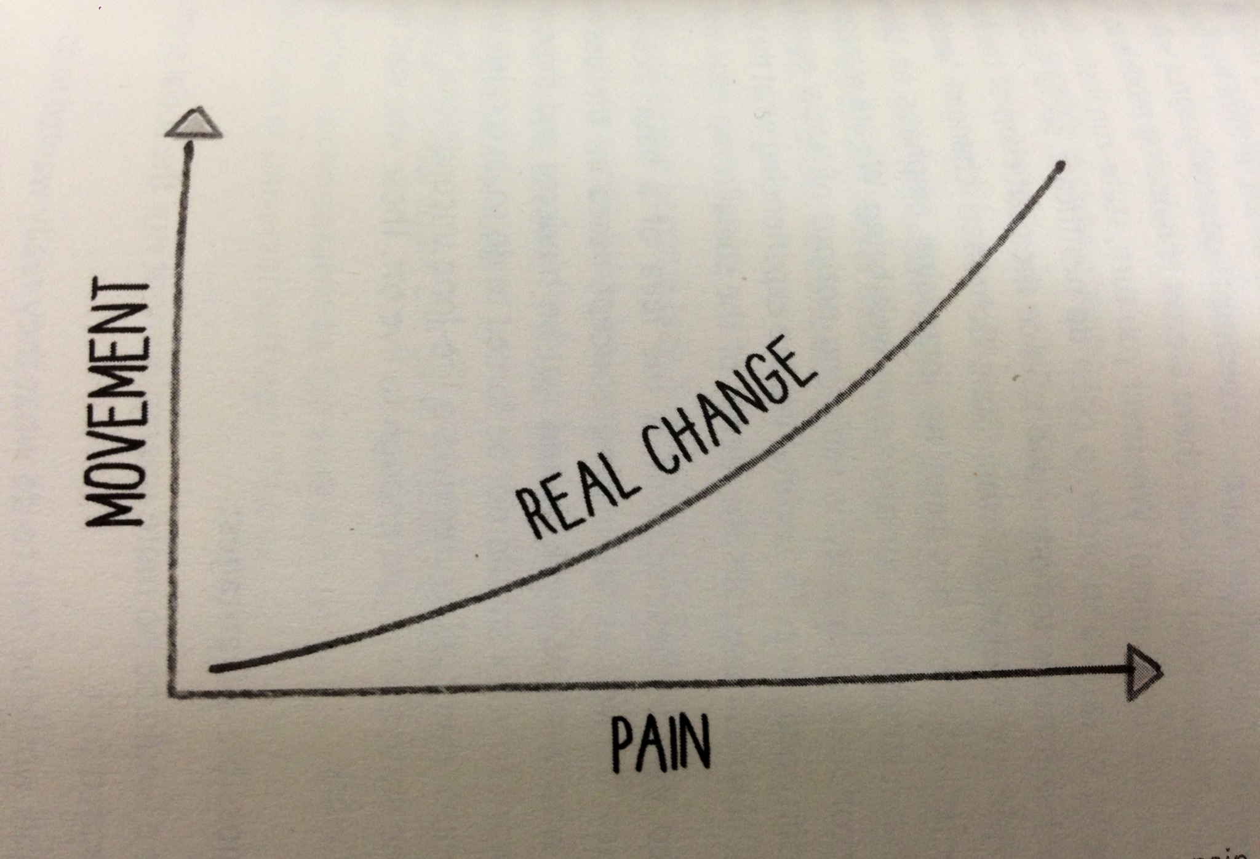
Why Change Hurts ?
Ketan Lakhani, South Africa

