Slide 1
MITHI
PAGBA
Iloilo City April 4-5, 2013

Slide 2
CURRENT SET-UP
DIFFERENT SYSTEMS AND RESTRICTED-ACCESS DATABASES
GOVERNMENT CULTURE OF TURF WARS
LACKING CONCEPT OF
INTER-OPERABILITY AND
INTER-AGENCY

Slide 3
ULTIMATE MITHIIN
TO HARMONIZE ALL
RESOURCES, PROGRAMS AND
PROJECTS OF THE WHOLE GOVERNMENT

Slide 4
GOVERNMENT-WIDE
EDIUM-TERM
M
I
T
H
I
NFORMATION AND COMMUNICATIONS
ECHNOLOGY
ARMONIZATION
NITIATIVE

Slide 5
BACKGROUND AND RATIONALE:
MEDIUM-TERM INFORMATION AND COMMUNICATIONS
TECHNOLOGY (ICT) HARMONIZATION INITIATIVE
MITHI is a process that will help the E-Gov Master Plan (EGMP) with a bottom-up perspective of their ICT needs, which shall then be "harmonized" for inclusion into the EGMP.
GOVERNMENT INFORMATION SYSTEMS PLAN
Issued through EO 265 on July, 2000
Framework and guide for computerization of
key frontline and common services and
operations of the government
FINAL OUTPUT:
Updated E-GOVERNMENT
MASTER PLAN
MITHI
GISP
GOVERNMENT INFORMATION
SYSTEMS PLAN
E-GOVERNMENT MASTER PLAN
Singular authoritative strategic blue print
for Philippine E-Governance.
Currently being formulated by DOST-ICTO;
intended to update the GISP.
EGMP

Slide 6
MITHIIN:
To ensure the coherence of ICT programs and projects of the Government and its consistency with the five (5) Key Result Areas (KRA) of the Administration as laid out in EO no. 43 and the Philippine Development Plan 2011-2016.
To ensure a systematic process for the planning, budgeting, implementation, monitoring, and evaluation of
government-wide ICT projects.

Slide 7
BENEFITS OF MITHI:
Coordinated ICT Programs and Projects
Enable bureaucracy to take advantage of:
VARIOUS SYNERGIES
ECONOMIES OF SCALE
IMPROVE THE PHILIPPINES’ GLOBAL
COMPETITIVENESS RANKING

Slide 8
LEAD AGENCIES:
ADVISORY MEMBERS:
PARTICIPATING AGENCIES:
Comprised of all Departments, Agencies, State Universities And Colleges (SUCs), Government-owned Or-Controlled Corporations (GOCCs), The Congress, And Constitutional Fiscal Autonomy Group (CFAG).

Slide 9
MITHI PROCESS
eGov Fund
Digital Empowerment Fund

Slide 10
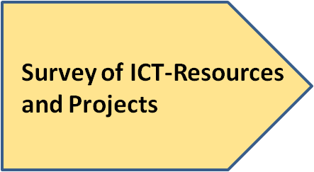
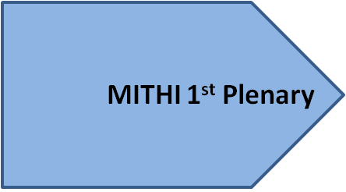
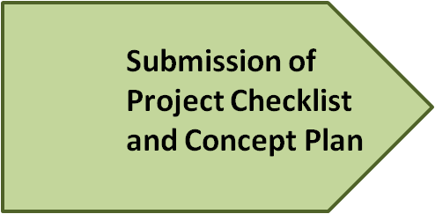
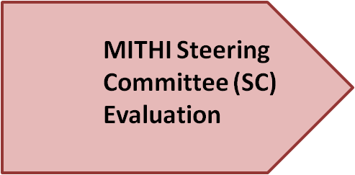
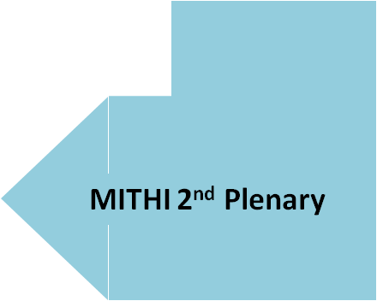
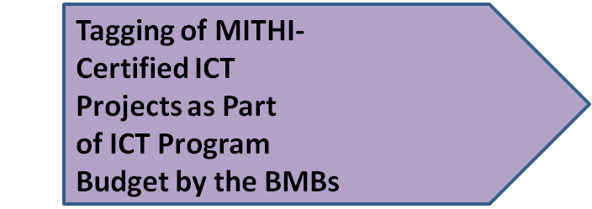
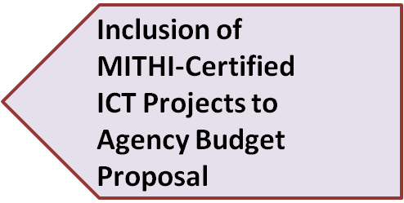
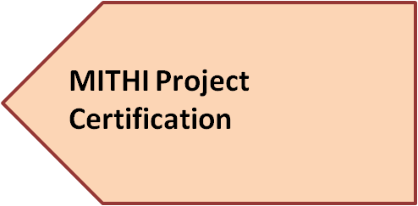
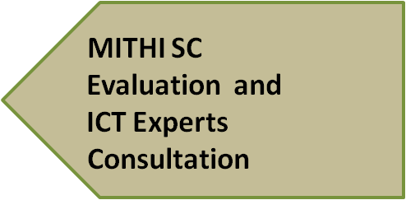
Stakeholder
Engagement
eGov Fund
Digital Empowerment Fund
Stakeholder Engagement
MITHI process will happen during the Stakeholder Engagement Phase of the Budget Process. MITHI seeks the participation of civil society organizations (CSOs) and IT associations so that a multi-sectoral technical evaluation of ICT-related resources, programs and projects can be done as departments, agencies and government-owned or controlled corporations craft their agency budget proposals (e.g. BP 202, 203).

Slide 11
MITHI hopes to restore faith in the System – a harmonized system, brought about by a coordinated sharing of information and resources.
MITHI SEEKS TO INSTILL
MITHI SEEKS TO INSTITUTIONALIZE
TEAMWORK
COMMITMENT
The Government
Civil Society Organizations
IT Associations
Private Sector Representatives

Slide 12
Thank You!

