Slide 1
Program Overview and Updates
April 2013
Notes:
Greetings! Thank you for inviting me here today to share with you a major reform agenda of the Philippine Government – the Public Financial Management Reform or PFM, for short.
I would like to begin with a video presentation on the PFM Reform called “The Story of Juan.” (PLAY VIDEO)
(NOTE TO PRESENTER)
Insert a short activity to help “warm up” the audience. Give a PFM collateral (e.g. mug) as prize.
Suggested Activity: Question and Answer/Quiz (1-2 questions only)
Question 1: Name three senior government officials in the video?
Question 2: Name one PFM project shown in the video?
Question 3: How many PFM projects are there? (Answer: 6 projects)
(Note: The question may be customized so it’s relevant to agency, e.g. name DOF officials if presentation is made to DOF officials)

Slide 2
Session Scope
Why the reform?
What do we want to achieve?
How do we achieve it?
Current PFM Situation
Project accomplishments and Updates
PFM Reform Roadmap and Executive Order 55
Notes:
Today, we hope to engage with you on a discussion about the PFM reform based on three key questions.
Why the reform?
What do we want to achieve?
How do we achieve it?
These questions are addressed in the Philippine PFM Reform Roadmap, which I hope you can take some time to read. For those who know what the reform is about, we hope to share with you updates and accomplishments on the various PFM initiatives taking place.

Slide 3
Why the reform?
Notes:
You are familiar with this picture, right? Yes, that’s Juan from our video presentation. Juan will guide us today with the key questions we hope to discuss. First, why the reform?
NOTE TO PRESENTER:
Presenter may do a short activity or tell a story about change that will help set a common and positive perspective about the reform.
Suggested activity: Visual association
Show picture of a chart or graph
Ask: what comes to mind when you see this picture?
Call volunteers to give answers (e.g. chart, performance, data, numbers, analysis, information, knowledge, decisions, etc.)
Summarize by saying:
Data, information and knowledge are what makes good analysis and sound decisions about policy and programs. Data, information and knowledge - these are what we envision to be at our fingertips, at the click of the mouse; analysis made easy and shown in our computer screens anytime, anywhere to help us make evidence-based, informed and sound decisions about how we can as government can best deliver public services. This may be new to you and me, but will result in an easier, more effective way of doing our business of government.

Slide 5
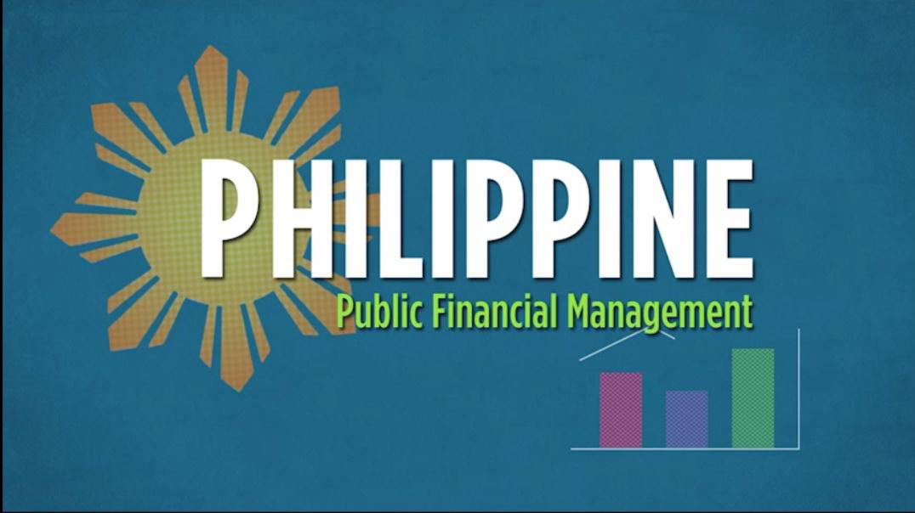
A system of rules, procedures and practices for government to manage public finances in the areas of
budgeting
accounting
auditing
cash management
management of public debt
revenue generation
public reporting on financial operations
Notes:
What is PFM? For clarity, we are using the term PFM in its widest sense, as a system of rules, procedures and practices for government to manage public finances.
It generally encompasses the following areas of government financial management:
budgeting
accounting
auditing
cash management
management of public debt
revenue generation, and
public reporting on financial operations.

Slide 6
PFM Cycle and Gaps
PREPARATION
lack of budget credibility
budget not results-based
lack of funding predictability
AUTHORIZATION
ACCOUNTABILITY
weak budget oversight by Congress and the public
weak cash management system
no common budgetary and accounting classification
weak monitoring of contingent liabilities
EXECUTION
Notes:
In 2007, a comprehensive assessment of the Philippine PFM system was done by the World Bank and AusAID using an evidence-based and results-oriented framework called PEFA or the Public Expenditure and Financial Accountability. The late DBM Secretary Emy Boncodin was part of this assessment team. DBM, DOF, COA and line agencies such as DEPED and DSWD participated in the assessment.
Our PFM system was evaluated against six benchmarks of a good PFM such as credibility of the budget; policy-based budgeting, predictability and control of budget execution; accounting, reporting and auditing systems; and external and public scrutiny, among others.
The slide shows the key findings from the PEFA assessment, which are described in the PFM Reform Roadmap. For example, the lack of a common classification of budgetary and accounting accounts leads to numerous, duplicative, inconsistent, unreliable financial reports to COA and DBM, as well as to the agency management.

Slide 7
What do we want to achieve?
Notes:
What do we want to achieve with the PFM reform?

Slide 8
PFM Policy Bases
Master plan for modernizing the financial management system of the government
Executive Order 55 (s. 2011) directs the integration and automation of PFM systems
Improve efficiency, accountability and transparency of public fund use
Contribute to good governance and fiscal discipline as a strategy for inclusive growth and poverty reduction
Notes:
The objectives of the PFM reform are contained in the PFM Reform Roadmap.
The PFM Reform Roadmap is a five-year master plan for addressing PFM gaps and improving the PFM systems in the whole of government. It contains specific strategies to address major gaps in the system through effective interventions in the short-term, medium-term and long-term towards improving transparency, accountability, efficiency and effectiveness of public funds use.
This roadmap was jointly formulated by the principal fiscal oversight agencies, namely DBM, COA and the Bureau of the Treasury through a series of stakeholder consultative meetings and workshops that began in 2009 and was formalized through Executive Order No. 55 signed by the President in September 2011.
EO 55 also established the PFM Committee composed of DBM, DOF, COA and Treasury as the governance structure responsible for the implementation of the roadmap and GIFMIS.

Slide 9
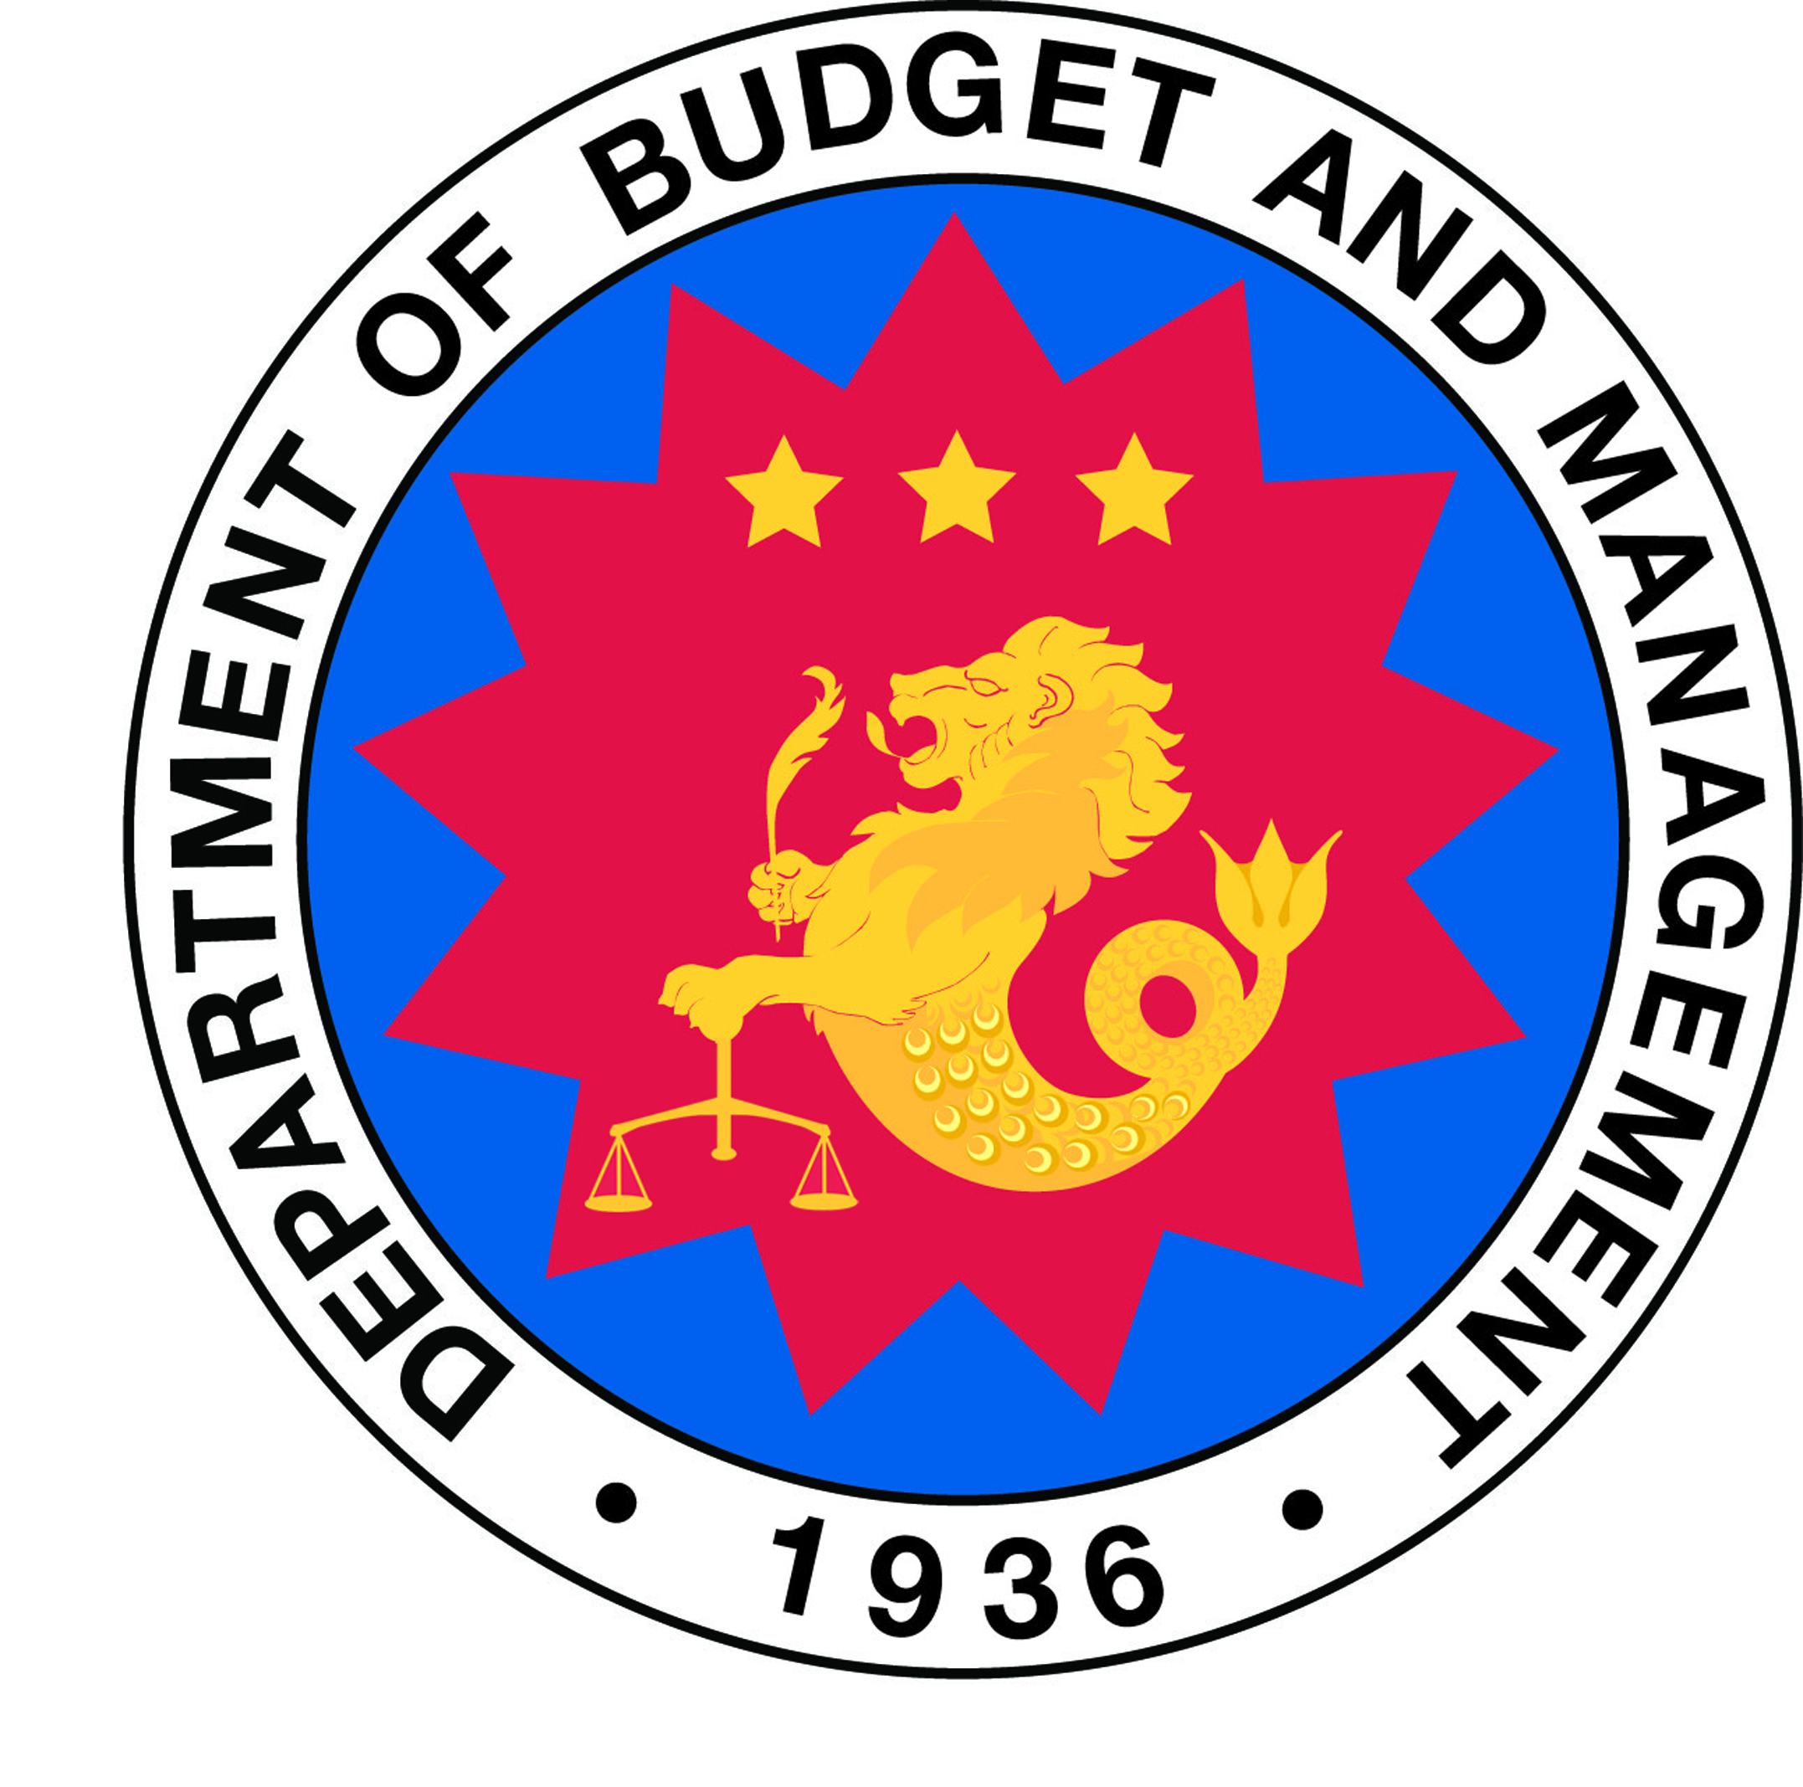
Reform Objective
Clarify, simplify, improve and harmonize financial management processes and information systems in the whole of government and as necessary reengineer and integrate relevant systems in COA, DBM, DOF and implementing agencies
Notes:
The aim of the PFM reform program is to clarify, simplify, improve and harmonize financial management processes and information systems in the whole of government.
This involves, as necessary, the reengineering and integration of relevant business processes and systems in COA, DBM, DOF and implementing agencies.

Slide 10
Desired Outputs
A Government Integrated Financial Management Information System (GIFMIS) and a Treasury Single Account (TSA) by 2016
Real-time on-line monitoring and control of obligations and direct links to cash disbursements
Consolidated financial management reporting requirements using harmonized classification of budgetary, treasury & general ledger accounts
A single treasury account for more effective cash management, reconciliation of bank balances and to remove revenue/expenditure floats
A predictable and streamlined allotment and cash release program
Regular in-year reports on budget execution, and timely year-end audit reports
Systematic recording and reporting of all liabilities including guaranteed and contingent liabilities
Notes:
The reform shall produce concrete outputs – a functional GIFMIS and TSA by 2016, with the desired outcomes:
Real-time on-line monitoring and control of obligations and their direct links to cash disbursements
Consolidated financial management reporting requirements using a harmonized classification of accounts including
Budgetary accounts – appropriations, allotments, obligations and expenditures
Treasury accounts – cash flow statements of the National Treasury
General ledger accounts – assets, liabilities, equity, income and expenses
A single treasury account that provides BTr a more effective way of cash management, a more economical system for cash disbursements, and enables it to reconcile bank balances and remove revenue and expenditure floats;
A predictable and streamlined allotment and cash release program throughout the year to support the operations of implementing agencies based on reliable cash forecasting and programming by DBM and the BTr;
Regular in-year reports on the status of budget execution, and timely year-end audit reports of agency financial and physical operations which will be used in the budget preparation process, the Congressional debate on agency budgets and performance, and the public’s participation in the budget process; and
Systematic recording and reporting of all liabilities of government entities including guaranteed and contingent liabilities to enable national government to manage its financial exposure.

Slide 11
How do we achieve the reform?
Notes:
Finally to our third key question: How do we achieve the reforms envisioned?

Slide 12
PFM Projects
GIFMIS
Budget Reporting & Performance Standards
Accounting and Auditing
Capacity Building
Liability Management
Treasury Cash Management Operations Improvement
Generate real-time, reliable, accurate financial info and reports for policy decision making
Improve cash management for operational efficiency
Harmonize and consolidate data structures and apply consistent set of budget and accounting rules for reporting
Enhance government accounting & auditing systems & standards & strengthen external and participatory audit capacity
Improve management of government’s contingent liabilities and financial exposure
Professionalize the PFM workforce and build stakeholder (Congress and civil society) support for reforms
Notes:
The strategies laid out in the PFM Roadmap are translated into operational terms through six projects:
GIFMIS Development
Budget Reporting and Performance Standards
Accounting and Auditing Reforms
Treasury Cash Management Operations Improvement
Liability Management, and
Capacity Building
Each project has its own focus and outputs, delivered through partner spending agencies, service providers and development partners like AusAID. The Philippine Government has allocated almost P1 billion of eGov funds to these PFM projects in addition to AusAID support of P1.2 billion in 5 years.
(NOTE: PROCEED TO SHOWING/READING EACH PROJECT OBJECTIVE)

Slide 13
What have we done so far?
Notes:
Since the signing of EO 55 in late 2011, what have we accomplished so far in implementing the reforms?

Slide 14
2012 Key Milestones
Unified Accounts Code Structure (UACS)
New Revised Chart of Accounts
Treasury Single Account Conceptual Design
Online Submission of Budget Proposal System
GIFMIS Conceptual Design
Notes:
In the past year, we have accomplished the following milestones or major outputs on target:
Unified Accounts Code Structure
New Revised Chart of Accounts
Online Submission of Budget Proposal System
Treasury Single Account Conceptual Design
GIFMIS Conceptual Design

Slide 15
Messy Traffic of Financial Reporting Activities
This is now…
In the long run, the Philippine PFM
needs this kind of information system
Notes:
A key milestone of the PFM program is the UACS or Unified Accounts Code Structure. To understand what the UACS is about, we need to understand one of the more visible PFM system gaps – the messy traffic of financial reporting – as described in the PFM reform roadmap document.
As the diagram shows, too many reports in duplicative and redundant formats, i.e. around 50 reports, are manually prepared by spending agencies and submitted to COA and DBM. In addition, info systems are fragmented, unlinked and produce data which cannot be reconciled and translated into useful information for meaningful analysis.
This “messy traffic of documents” results in poor reporting and monitoring of fund utilization, and yes, weak accountability systems. And as we know, poor reporting leads to poor planning and budgeting, which leads to poor execution of the budget, inefficiency and even waste.
In the long run, we want to see a more systematic, integrated and orderly PFM system and information system that will remove the messy traffic of financial documents and improve PFM by making available real time, reliable and accurate financial information for decision making.

Slide 16
Unified Accounts Code Structure
2012 Key Milestones
Provides a harmonized budgetary and accounting classifications and codes for
identifying
aggregating
budgeting
accounting
auditing
reporting of financial transactions of government
UACS enables comparison of
allotment releases vs. appropriations,
obligations vs. releases, and
actual disbursements vs. obligations for programs of spending agencies
Notes:
A way out of the “messy traffic” of financial reporting is the UACS or Unified Accounts Code Structure – a major reform output in 2012.
UACS provides a single classification system from budgeting and accounting to financial reporting. With UACS, oversight agencies and spending agencies will now use a common chart of accounts and codes to logically identify, track and report financial transactions according to funding, organization, location, MFO/PAP and and object code.
UACS will also enable reporting of actual revenues collections and expenditures compared with programmed revenues and expenditures.
UACS allows for the comparison of:
allotment releases vs. appropriations,
obligations vs. releases, and
actual disbursements vs. obligations for programs/activities/projects of spending agencies
Training on UACS and the UACS-compliant OSBPS began in March 2013 and will continue the rest of the year as we move to the budget execution and accoumtabili8ty phases. Likewise, UACS training and change management activities will be synchronized with the training on COA’s new Revised Chart of Accounts that will start May 2013.

Slide 17
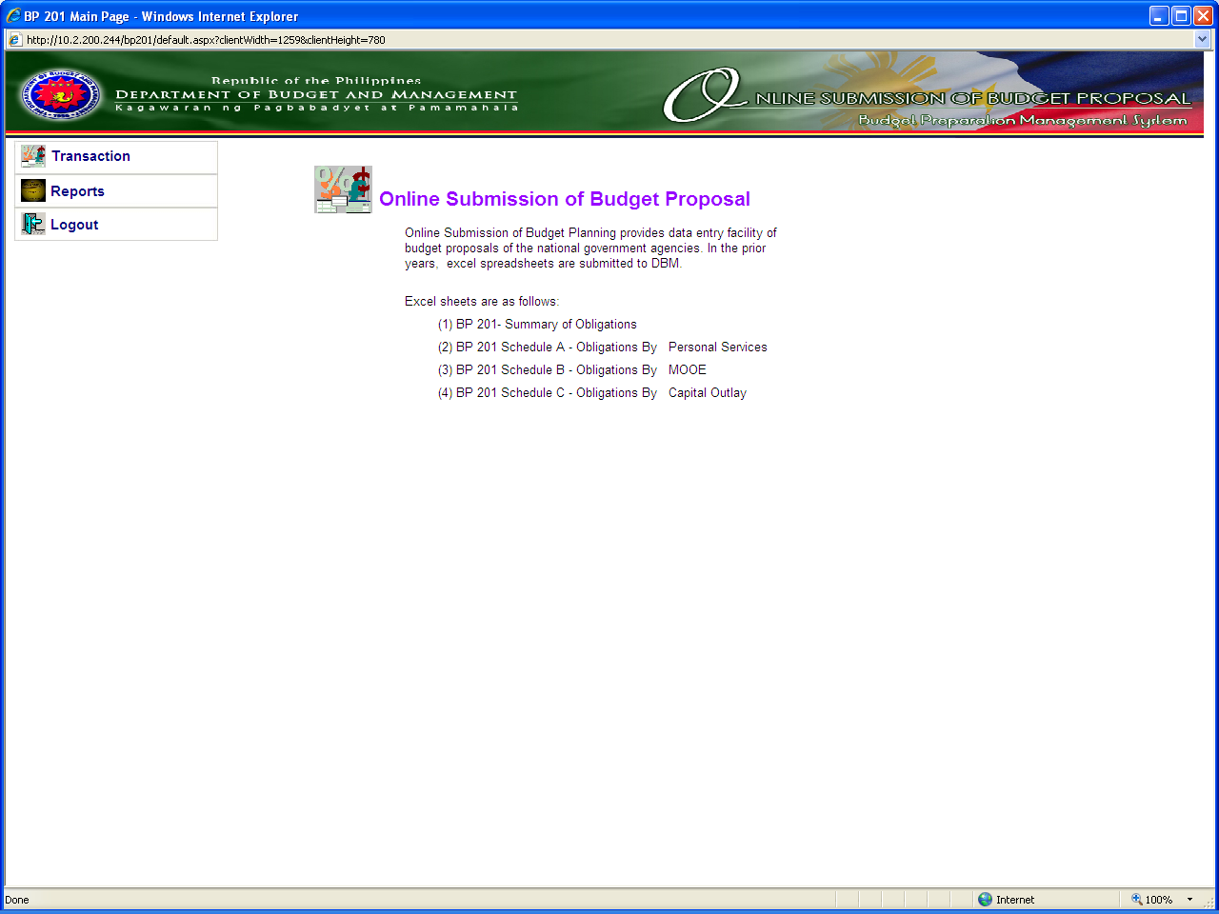
Online Submission Of Budget Proposal System (OSBPS)
2012 Key Milestones
Notes:
One of the key applications of UACS is budget preparation. Budget preparation and proposal submission is now made UACS-compliant with the rollout of the OSBPS or Online Submission of Budget Proposal System to spending agencies starting with the FY2014 budget preparation.
OSBPS aims to replace the paper and/or Excel files submitted by spending agencies to DBM. With OSBPS, spending agencies can now encode their budget proposals directly into OSBPS. OSBPS data in turn will be automatically uploaded in the DBM’s Budget Preparation Management System (BPMS) to enable the preparation of the National Expenditure Program (NEP) for submission to Congress.

Slide 18
Treasury Single Account (TSA) Conceptual Design
2012 Key Milestones
Assessed Gaps
Agency budgets are under executed
Proliferation of bank accounts
Idle cash balances often fail to earn income
Unnecessary borrowing costs to cover perceived cash shortage
Idle cash balances in the public banks used to extend credit to the public sector, or to buy bonds
Actions Taken
Inventory of agency bank accounts
Conceptual design to implement a TSA to
provide a unified structure of govt bank accounts
enable consolidation and optimum utilization of government cash resources
centralize revenue collections and payments process at the Treasury
Notes:
An assessment study conducted in 2012 showed that the budget is systematically under executed -- from 10 to 21 % over the past few years. The problem is partly caused by weak monitoring and forecasting of revenue collections and agency disbursements and by the proliferation of bank accounts outside Treasury control.
The same study validated the problems of inefficient cash management and showed that the cost of fragmented cash position is high. Why?
Idle cash balances in bank accounts often fail to earn market-related income
The Government incurs unnecessary borrowing costs on raising funds to cover perceived cash shortage
Idle government cash balances in the public banking sector are used to extend credit to the public sector, or to buy bond,
To address these issues, the Government has almost completed the inventory of agency bank accounts in order to bring them all under a Treasury Single Account. Through a Treasury Single Account and GIFMIS, Government will be able to centralize revenue collections and payments process. The proposed conceptual design and operational framework of TSA is currently being studied by our Government for implementation as part of the GIFMIS development.

Slide 19
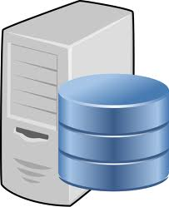
GIFMIS
GIFMIS is an integrated web-based financial management information application:
Automate financial functions and operations – financial planning and budgeting, treasury and accounting
Collect and organize financial information in a central database
Generate real-time, reliable and accurate financial info and reports for policy decision making
Notes:
A key PFM project is the development of the Government Integrated Financial Management Information System or GIFMIS. The aim is to develop a working GIFMIS that can collect and organize financial information in a central database.
GIFMIS is envisioned to be operational by 2016, however the rollout of specific module applications on budget preparation and management, expenditure management, accounting and reporting, revenue management, human resource information (GHRIS) and national payroll system (NPS) will be phased throughout 2013 to 2015. Set for pilot and rollout in 2013 are the NPS, the GHRIS, the Online Submission of Budget Proposal, and the enhanced Budget Preparation system.

Slide 20
Ongoing Initiatives
Harmonized Financial Accountability Reports
(Joint Circular 2013-1)
Exposure of the Phil Public Sector Accounting and Auditing Standards and Manuals
Inventory of Agency Bank Accounts for
TSA readiness
Database for GOCC Debt
Notes:
Under the leadership and management of the PFM Committee, Project Teams, and PFM Program Management Office, there are many ongoing initiatives for PFM reform. These initiatives support the key milestones discussed earlier particularly the UACS and readiness for GIFMIS.
Ongoing initiatives include the following: (READ slide)
Harmonized FARs - COA and DBM issued Joint Circular 2013-1 on March 15, 2013 on the Revised Guidelines on the Submission of Quarterly Accountability Reports on Appropriations, Allotments, Obligations and Disbursements. It aims to ensure timely, complete, accurate submission of these financial reports.
COA is currently exposing or cascading 23 new accounting standards and 70 auditing standards, which were harmonized based on Phil and international standards (IFRS and IPSAS). New handbooks and manuals to support government-wide training will be available soon. Other COA initiatives are the development and implementation of enhanced tools for Information Technology/Systems Audit, a web-based Integrated Results and Risk-Based Audit Software (IRRBAS), and participatory audit.
Department of Finance is completing its database for GOCC debts as part of its efforts to improve the management including recording, monitoring and reporting of contingent liabilities, and reduce the Government’s exposure to financial risks.

Slide 21
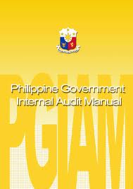
Ongoing Initiatives
Internal Audit and Internal Control Training
IEC activities and PFM Competency Model Initiative
Rollout of UACS, Revised CoA
and OSBPS
GIFMIS Functional and Technical Requirements Gathering
Notes:
In 2012, DBM together with the Office of the President Internal Audit Office rolled out training of Internal Audit staff across government on the national guidelines on internal control and the Philippine Government Internal Audit Manual (PGIAM). The PGIAM training continues in 2013 for the remaining 41 agencies.
To create continuous support and energy for the PFM reform among government staff and managers, Congress, professional associations and civil society stakeholders, the PFM Committee continues to conduct awareness briefings and communication activities throughout the year. Information, education and communication (IEC) activities will continue year-round to support the long term strategy of building individual and organizational capacities for PFM.
Let’s talk about building your individual skills and competencies in the next slide.
As mentioned earlier, we continue to rollout key milestones from last year particularly the UACS and Revised Chart of Accounts as we go into budget execution and accountability phases.
In April 2012, data gathering and consultations with agency budget, accounting, HR and payroll staff and agency managers resume to enable the GIFMIS Project Team to prepare the functional and technical specifications. These specifications are required for the preparation of bidding documents to procure the GIFMIS application.

Slide 22
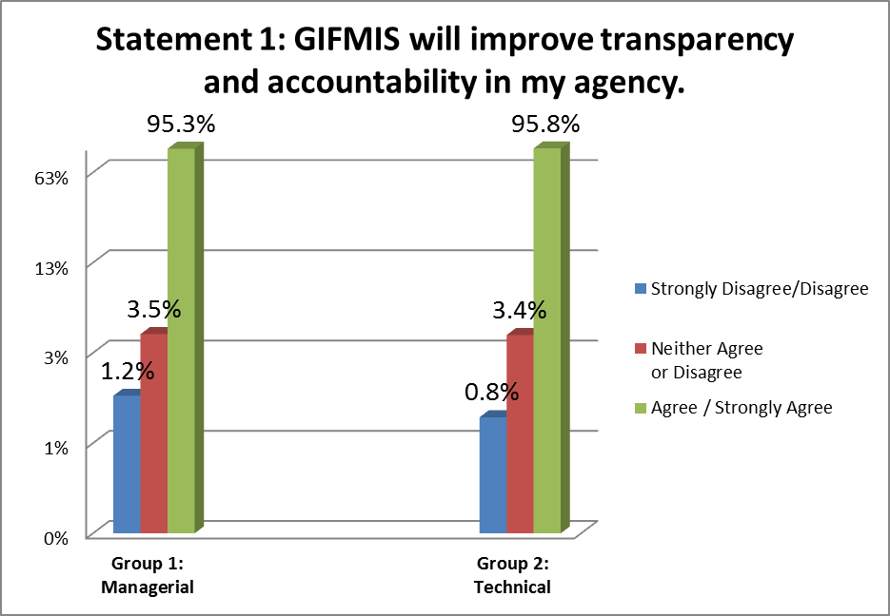
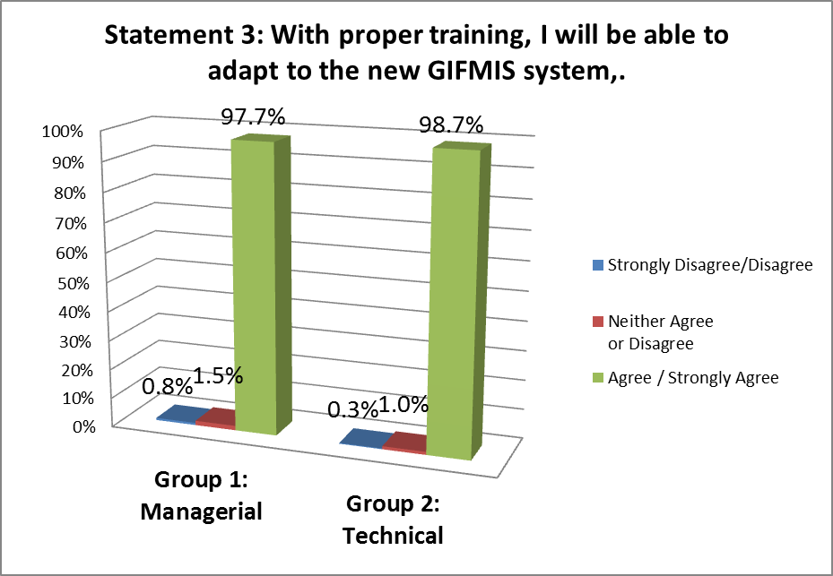
Is government ready for change?
GIFMIS will improve transparency and accountability in their agencies
High need of both the managers and technical groups for proper training to adapt to the new systems
Notes:
In a May 2012 survey, 645 respondents consisting of 264 Managers and 381 Financial Management Technical Staff of NGAs responded to a set of change readiness questions about GIFMIS. The results showed strong positive agreement among managers and staff on the importance of GIFMIS as shown in the slide.
The survey also indicated a need for senior managers to clearly communicate and champion the reforms to their staff.
It also validated the felt need among staff and managers for training on GIFMIS and skills needed to function effectively in their new roles and tasks.

Slide 23
PFM Capacity Building
LEARNING AND DEVELOPMENT PROCESSES
DESIRED OUTPUT/OUTCOME
INPUT
Awareness Briefings and Consultations and Business Process Reviews with Stakeholders
Informed and educated PFM executives, managers, employees, public, CSO stakeholders, etc.
PFM Competency Framework
Functional Users Training
Reengineered Business Processes
GIFMIS Systems
Global
Better Practices
Professional, competent PFM workforce in budgeting accounting, internal audit, treasury management, revenue management, govt IT
audit, etc.
Reengineered Business Processes
IT Technical Users Training
Reengineered Business Processes
GIFMIS System
GIFMIS
Systems
Professional Development Courses
Productivity Tools, Financial Analysis, Ethics and Accountability,
PFM Competency Based Education & Training leading to certification, diploma or master’s degree in PFM
Transparent and accountable PFM systems, etc.
Monitoring and Evaluation
PFM 2012
Notes:
The program recognizes the importance of building capacities through training and communications as change management strategies. The slide shows how learning and development strategies will be deployed to generate your support as key stakeholders and to professionalize the PFM workforce. Jobs will not be lost, because those affected by the reengineered processes will be retrained and retooled for their redefined job roles and tasks, and towards a mindset and culture of results orientation and accountability.
In the short term, there will be orientation and workshops on various policy driven reforms, and user training on enhanced IT-based systems such as OSBPS and UACS.
How many times have you asked the questions: How do I grow in my job or profession? When do I get promoted? I don’t have the specific answers for you; my last promotion was 5 maybe 10 years ago. Joking aside, I think this will help answer these valid questions.
A key milestone expected in 2013 is the 6 month competency study that will go a long way towards professionalizing the PFM workforce. This initiative is about developing a PFM Competency Model and qualifications standards as basis for training, learning, career development and promotion of staff at all levels of PFM jobs, in both spending and oversight agencies.
The PFM competency model will define what training an individual, say a Budget Officer 1, will need to gain national skills qualifications or certification. This qualification will be the basis for promotion to the next level, or even movement to another PFM related job. This means “no” to sporadic, random, piecemeal training, but ‘yes’ to sustained, competency-based training that build skills progressively and supports application of new skills and attitudes back in the workplace.

Slide 24
Critical Path to GIFMIS
Management/Organizational
Policies, Processes, Systems
Political
Leadership
Executive Order 55
Policy Decisions
GIFMIS concept
Business process changes
Functional assignments
Business Changes
Harmonized accounts
Treasury Single Account
Centralized payments
Institutional Structures and Plans
PFM Roadmap
PFM Governance
Program Management Office
Change Management
Capacity Building
Communication
Development
Functional Design
System design
Procurement
GIFMIS
People/Resources
Finances/Budget
Notes:
In summary, critical systems planning and design occurred for the UACS, GIFMIS and TSA in 2012. This is laying a sound, evidence-based foundation to inform major egovernment investment decisions.
In 2013, we move to the implementation phase of these initiatives. More than ever, the program will need full time personnel to implement the activities and sustain the improvements. There will also be need for extensive capacity building and business process reviews to prepare the PFM workforce for their new roles, and new policies and procedures.

Slide 25
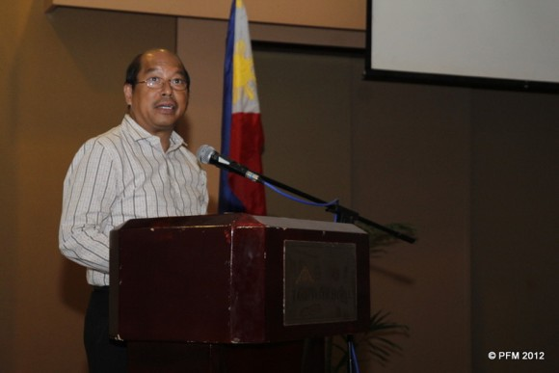
“To ensure both the adequacy of public resources and the results per peso spent, we need a stable and enabling PFM system… comprehensive enough to cover the moment when taxes are collected to the point where suppliers of government are paid, and up to that point when the auditor takes stock of how these funds were used. This PFM system shouldn’t be purely financial, for it has to take into account the actual, concrete results on the ground brought about by the use of public resources.”
“There’s more to PFM than merely installing a new ICT system or shutting down bank accounts… through PFM we ultimately want greater accountability to be embedded in how we in government use the people’s hard-earned taxes.”
-- DBM Secretary Florencio B. Abad
PFM Roadmap Briefing 8 March 2012
Notes:
Let me end this presentation with this quote from Secretary Abad of the DBM.
Thank you and we hope we can count on you to support the PFM Change!

Slide 26
Thank you!
www.pfm.gov.ph

Slide 27
Revised Chart of Accounts
2012 Key Milestones
COA Circular 2013-002, 30 Jan 2013
Revised the NGAS chart of accounts to provide new accounts for adoption of the Philippine Public Sector Accounting Standards (PPSAS)
Major component of the Unified Accounts Code Structure (UACS) to ensure comparability of financial information from budgeting and accounting systems
Government-wide training on the revised CoA and exposure of the new PPSAS expected to begin in May 2013
Notes:
Remember the problem of “messy traffic of documents”? To address this and the need for more efficient financial reporting system, the Commission on Audit issued a circular in January 2013 adopting the revised chart of accounts. The new chart of accounts is a huge part of the Unified Accounts Code Structure (UACS), in particular the Object Coding structure. It also provides for new accounts that have been harmonized with the Philippine Public Sector Accounting Standards.
COA had worked closely with DBM in the past year to get the accounts for budgeting and accounting unified and harmonized---a major achievement towards realizing GIFMIS. We can expect training on the chart of accounts in May, complementing the UACS rollout to NGAs.

Slide 28
Auditing Mgmt (IRRBAS)
Asset Management
Government EIS
(GEIS)
Procurement
(PhilGEPS)
User
GIFMIS
Fiscal Simulation
Business Intelligence
Portal
UACS
Budget Preparation
Data
Warehousing
Vendor/
Supplier
Public
Employee
Creditor
UACS
Budget Management
UACS
Budget Execution
UACS
UACS
Commitment Management
Debt Mgmt
(DMFAS)
Accounting & Fiscal Reporting
UACS
Payments Management
Central Bank &
Government Servicing Banks
(TSA)
Commercial Banks
UACS
Cash Management
UACS
Receipts Management
Securities Management
Human Resources Management
Revenue Management
Plantilla
(GMIS)
Payroll
(NPS)
Internal Revenue (BIR)
Customs (BOC)
UACS
UACS
UACS
Notes:
Why is UACS considered a huge and important achievement for PFM reform?
UACS is a precondition to the development of the GIFMIS IT system. It will be applied to various PFM systems and processes covered by GIFMIS as shown in the slide i.e. budget preparation, budget management, budget execution, cash management, and payroll management, among others.

Slide 29
GIFMIS Conceptual Design (The “To Be”)
2012 Key Milestones
Blueprint for the GIFMIS system
Business Process to be supported (SCOPE)
Public Sector Units to be covered (COVERAGE)
Nature and extent of support (FUNCTIONALITY)
Notes:
GIFMIS Conceptual Design provides the Government of what is TO BE, a picture or blueprint for the GIFMIS system – in terms of scope, coverage and functionality.
It was developed through consultations, workshops and meetings and data gathering and analysis activities with PFM stakeholders particularly from functional users or those who know and own the Business process- budget officers, accountants, budget analysts, finance managers and key executives and officials from oversight and spending agencies.

Slide 30
Auditing Mgmt (IRRBAS)
Asset Management
Government EIS
(GEIS)
Procurement
(PhilGEPS)
User
GIFMIS
Fiscal Simulation
Business Intelligence
Portal
Budget Preparation
Data
Warehousing
Vendor/
Supplier
Public
Employee
Creditor
Budget Management
Budget Execution
Commitment Management
Debt Mgmt
(DMFAS)
Accounting & Fiscal Reporting
Payments Management
Central Bank &
Government Servicing Banks
(TSA)
Commercial Banks
Cash Management
Receipts Management
Securities Management
Human Resources Management
Revenue Management
Plantilla
(GMIS)
Payroll
(NPS)
Internal Revenue (BIR)
Customs (BOC)
Notes:
This is the picture of GIFMIS
GIFMIS will have the following scope as shown in the blue box:
Fiscal Simulation (i.e. Macro-economic Forecasting)
Budget Preparation
Budget Management
Commitments Management
Payments Management
Receipts Management
Cash Management
Accounting and Fiscal Reporting
GIFMIS Portal
Data Warehousing, Business Intelligence, Analysis and Reporting Tools
GIFMIS will interface with other existing and new IT-based PFM systems to be developed such as payroll and integrated HR information systems.
Asset Management
Debt Management (DMFAS)
Human Resource Management (GMIS/GHRIS)
National Payroll System (NPS)
Tax and Revenue Management (e-TIS, Customs System)
Auditing Management (IRRBAS)
Public Procurement Management (PhilGEPS)
Current Budget Preparation (BPMS)
Banking Systems (Systems at the Central Bank, GSB and Commercial Banks, etc.)
Government Executive Information System (GEIS)
Securities Management (for BTr)

Slide 31
GIFMIS Timelines
Functional & technical specifications (Apr2013)
Bidding & Selection (Jul2013)
Business process review (Aug2014)
System devt configuration & customization & testing (Apr2015)
User training (Sep2015)
Phase 1 Go Live for Pilot (Oct2015)
Notes:
Based on this timeline, the Government is now in the process of defining functional and technical specifications required for preparing the bidding or procurement document. Critical milestones are shown in the slide leading to Go live for the pilot agencies by October 2015

Slide 32
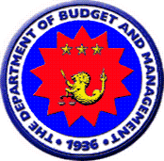
GIFMIS Pilot Implementation
Notes:
GIFMIS will be piloted in the following spending and oversight agencies.

